Slide 1
Loan Default Prediction
BY: Tiffany De La Cruz, Uyenmy Nguyen, Ewere Alizomor

Slide 2
Background:
Financial loan services are leveraged by companies across many industries, from big banks to financial institutions to government loans. One of the primary objectives of companies with financial loan services is to decrease payment defaults and ensure that individuals are paying back their loans as expected. To do this efficiently and systematically, many companies employ machine learning to predict which individuals are at the highest risk of defaulting on their loans, so that proper interventions can be effectively deployed to the right audience.

Slide 3
Research Question & Objectives
Can we build a model that predicts whether a borrower will default on a loan based on their financial history and demographic/loan characteristics ?
OBJECTIVES / SUBGOALS:
Maximize Accuracy: | Achieve high accuracy in predicting whether a borrow will default Recall, F1 – score, AUC
Minimize False Negatives and False Postives | Balance the model's performance to avoid incorrectly approving risky loans (false positives) and incorrectly denying good loans (false negatives)

Slide 4
FLOWCHART
Research Question
Data Understanding
Data Preprocessing
Evaluation
Training
Model Selection
Final Model

Slide 5
01
Data Understanding
Data Exploration & Data Quality

Slide 6
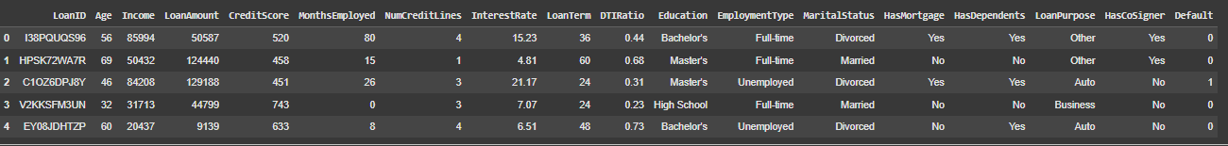
Data Overview
Dataset: Loan Default Prediction Dataset
Shape : Rows - 255347 , Columns – 18
Features: LoanID, Age, Income, LoanAmount , Credit Score, Months Employed , NumCredit Lines, Interest Rate, Loan Term DTIRatio, Education, EmploytmentType, MartialStatus, HasMortgage, HasDependents, LoanPurpose, HasCosigner, Default
Target variable: Default (binary: 1 = defaulted, 0 = Not Defaulted)

Slide 7
02
Exploratory Data Analysis

Slide 8
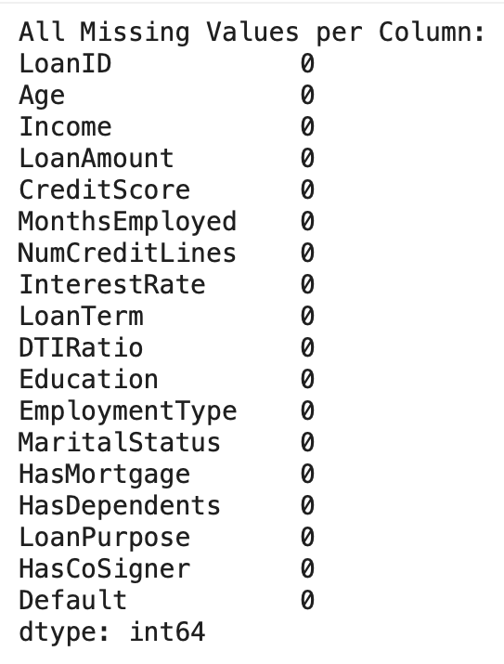
Missing Values & Data Types
Missing Values : NONE
Numerical Features: Age, Income, Loan Amount, Credit Score, Months Employed, NumCreditLines, Interest Rate, Loan Term, DTI Ratio
Categorical Features: Education, Employment Type, Marital Status, Has Mortgage, Has Dependents, Loan Purpose, Has CoSigner

Slide 9
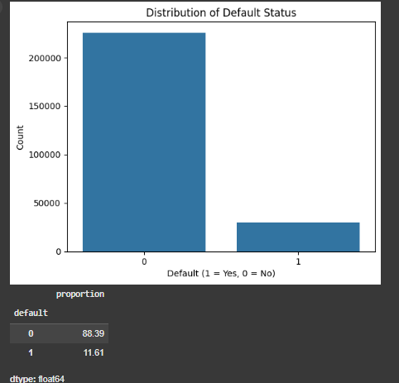
Imbalanced
The dataset is highly imbalanced:
88.39% of records are non-defaults (class 0)
Only 11.61% are defaults (class 1)
This imbalance can:
Skew model performance toward predicting non-defaults
Lead to poor recall and F1-score for defaulters
Require techniques like SMOTE, class weighting, or threshold tuning.

Slide 10
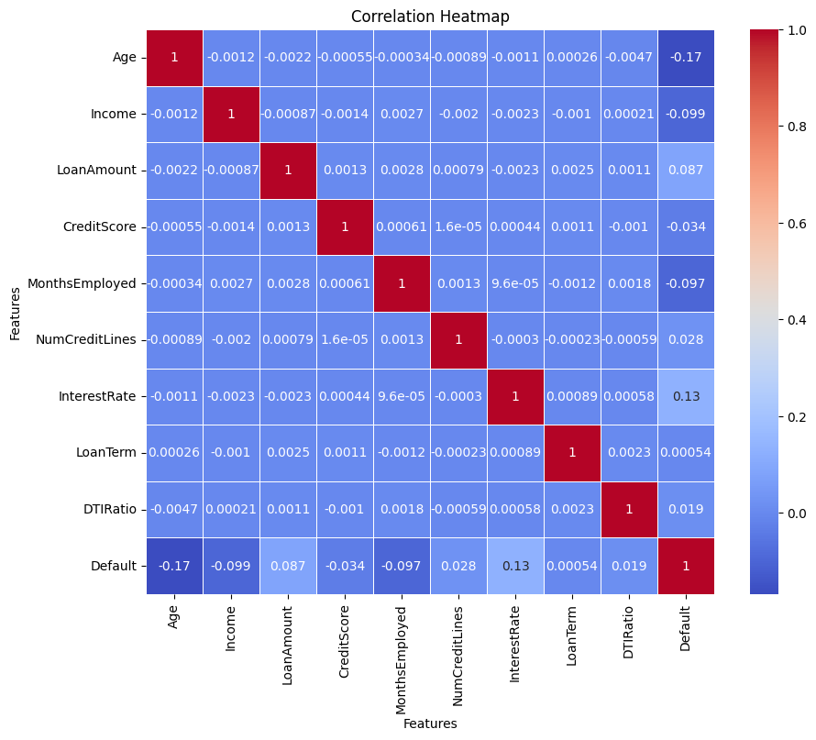
Correlation of Numerical Features
Age: - 0.17
Income: - 0.099
Interest Rate: 0.13
Month Employed: -0.097
Loan Amount: 0.087
Other Features: No Linear Correlation
Notes:
Relationship Correlation Interpretation:
Age vs Default-0.17 Older individuals are slightly less likely to default on loans.
Income vs Default-0.099 Higher income is weakly associated with a lower chance of default.
InterestRate vs Default0.13. Higher interest rates slightly increase the likelihood of default.
MonthsEmployed vs Default-0.097 People with longer employment are slightly less likely to default.
LoanAmount vs Default0.087. Borrowing larger amounts has a weak positive relation with default.
Other feature pairs≈ 0. Virtually no linear correlation between them (independent).

Slide 11
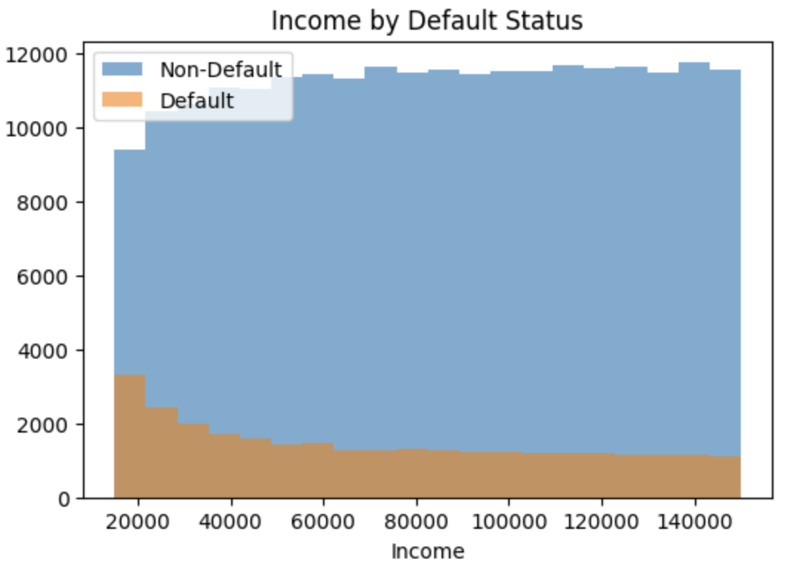
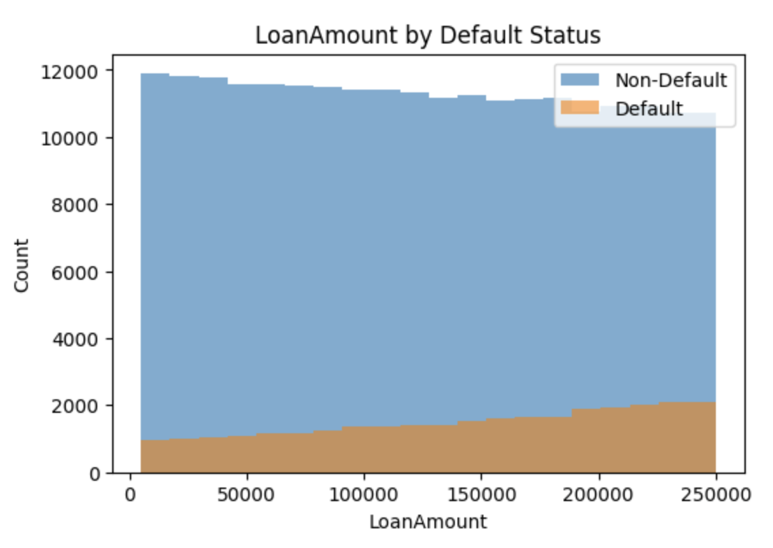
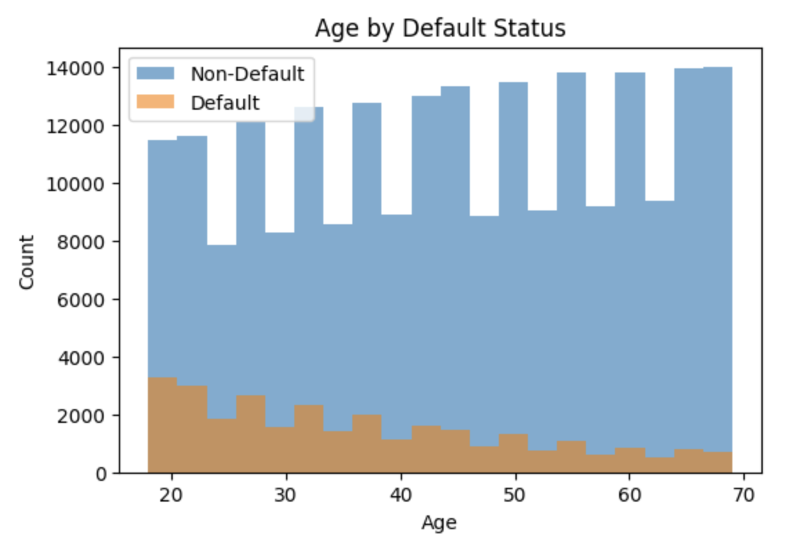
Target Distributions
The "Income by Default Status" histogram shows:
Defaults are more frequent at lower income levels
As income increases, default counts drop
The "LoanAmount by Default Status" chart shows:
Defaults increase slightly with higher loan amounts
Non-defaults dominate across all loan sizes
The "Age by Default Status" chart shows:
Younger individuals default more often
Default rates decline with age

Slide 12
03
Data Preprocessing

Slide 13
Handling numerical/categorical features
Split the column into 2 baskets (numerical/categorical):
Fill missing values with median
One-hot encoding applied
Combine in one clean numeric matrix
Notes:
No missing Values
No Outliers

Slide 14
04
Modeling

Slide 15

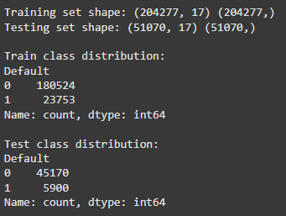
Train-Test-Split
Set up Target Variable
20/80 test-train

Slide 16

SMOTE

Slide 17
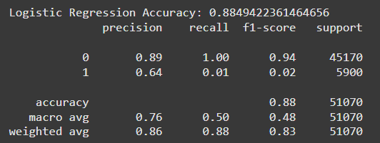
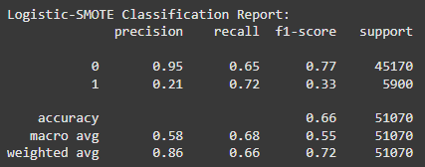
Logistic Model

Slide 18
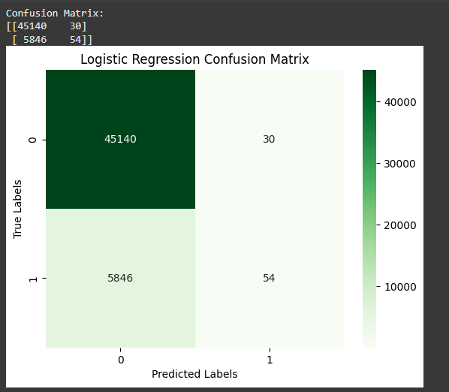
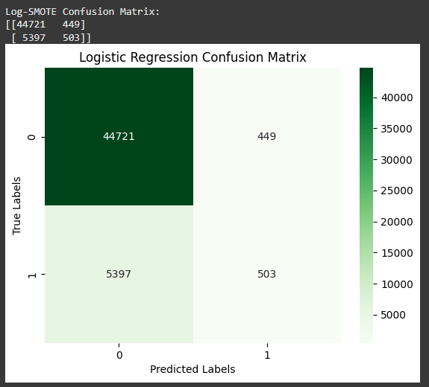

Slide 19
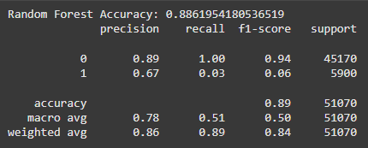
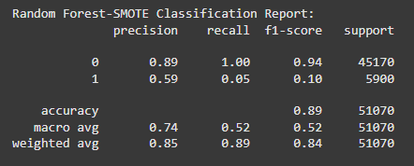
Random Forest
Random Forest (No SMOTE)
Accuracy: 88.6%, but misleading due to class imbalance
Model is biased toward majority class
Random Forest + SMOTE
Accuracy: 89%, same as baseline.
SMOTE helped a little, but model still struggles with minority class.

Slide 20
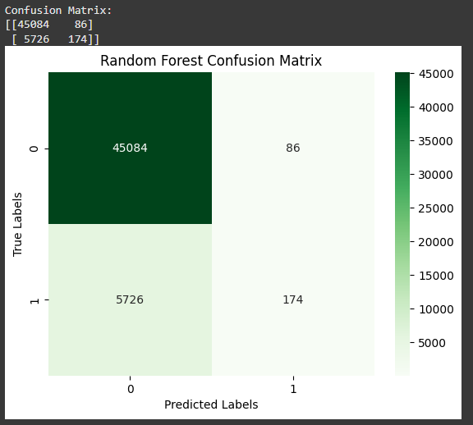
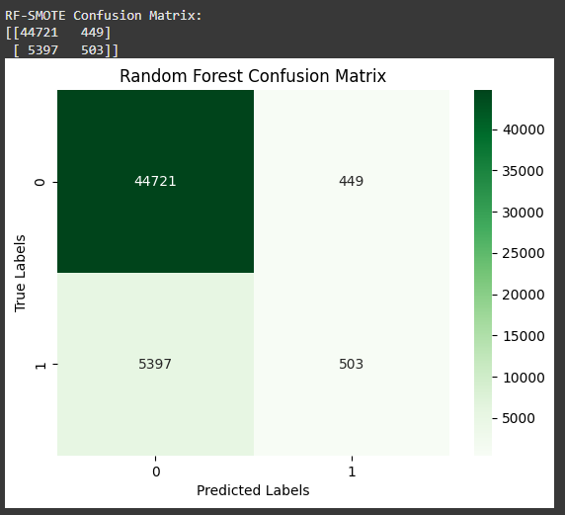
Before SMOTE After SMOTE

Slide 21
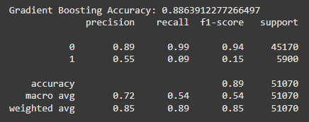
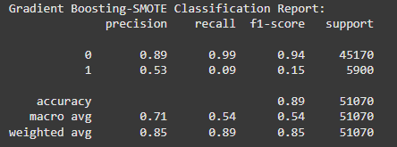
Gradient Boosting

Slide 22
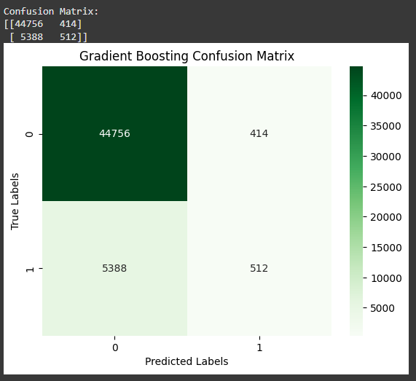


Slide 23
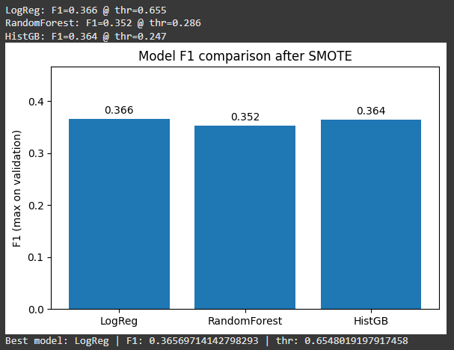
F1-Score comparison model with SMOTE
Hyperparameter Tuning

Slide 24
05
Evaluation & Results

Slide 25
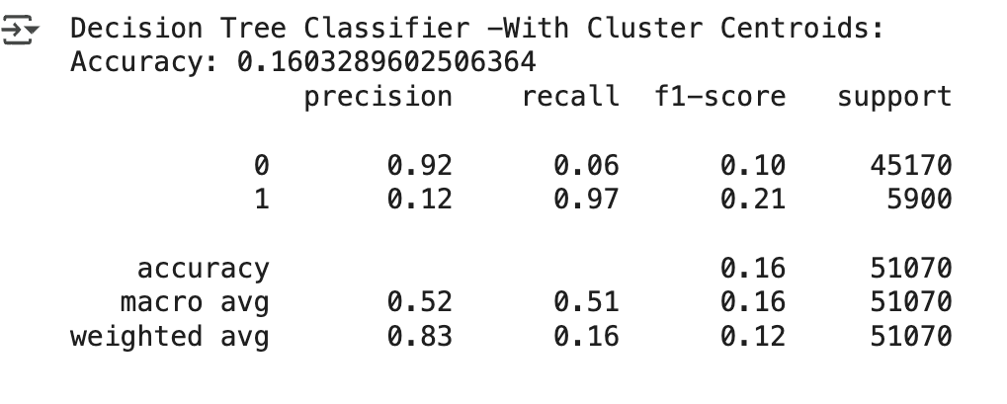
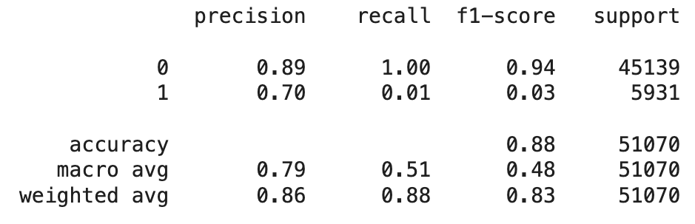
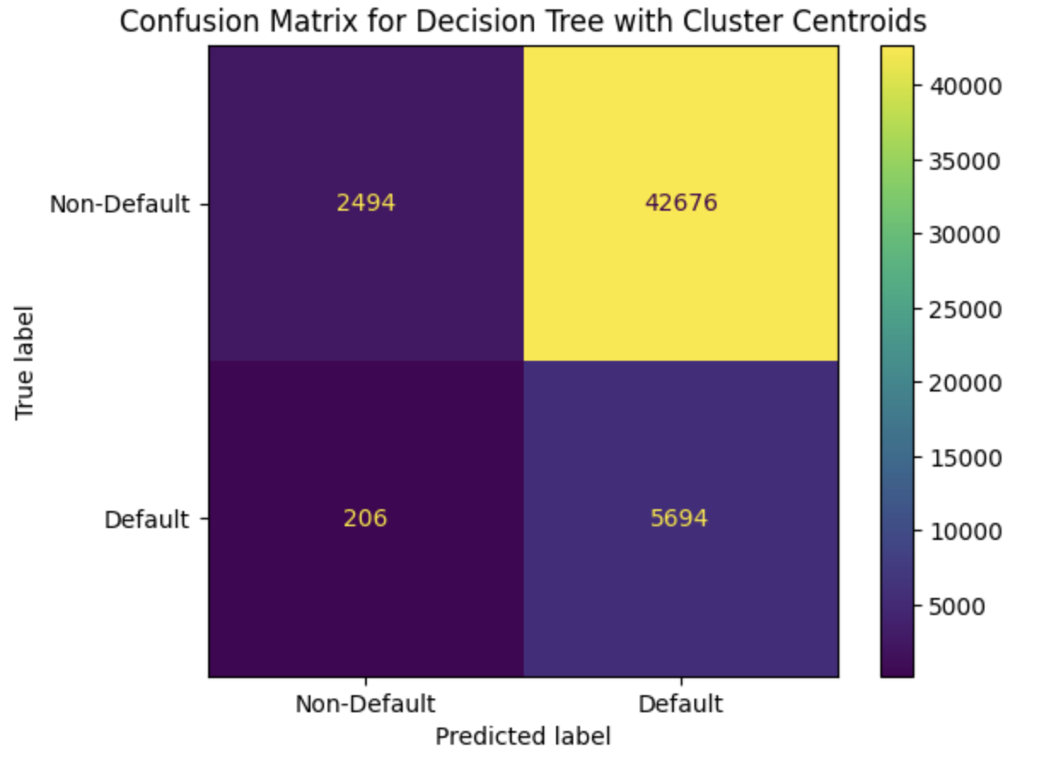
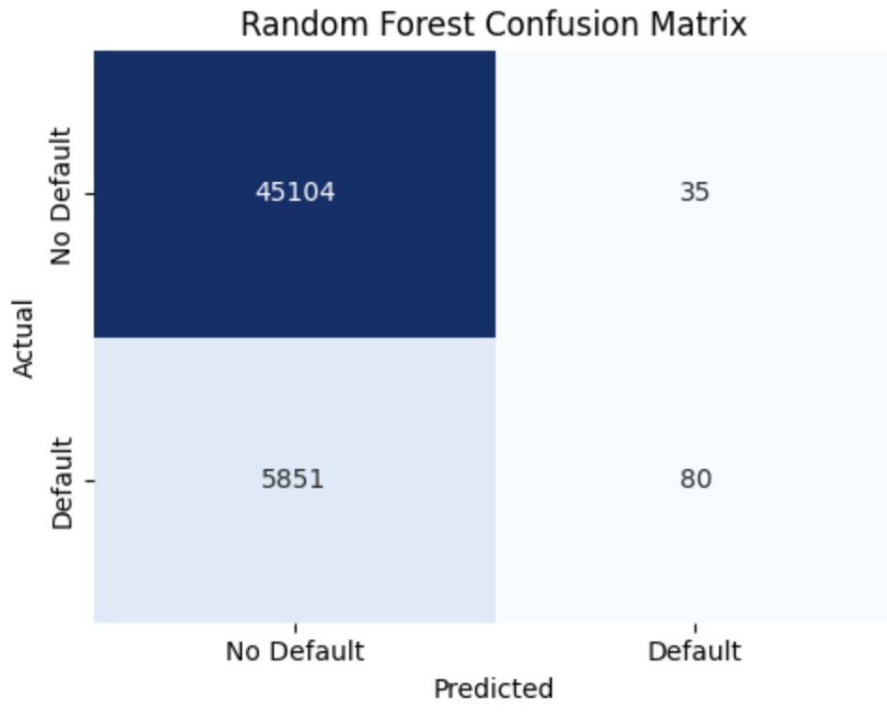
Results & Insights
High Recall & Low Precision
High Precision & Low Recall
Notes:
The Random Forest performs very well for “No Default” but fails for “Default.”
This is a classic imbalance problem — the model is biased toward the majority class.
The business impact: The company would approve too many risky loans, resulting in financial losses.
Therefore, simply having a high accuracy is misleading — recall is the critical metric here.
Compared to your Random Forest, this model shows the opposite trade-off:
Random Forest → High accuracy, poor recall for defaults
Decision Tree + Cluster Centroids → Low accuracy, high recall for defaults
This means you’ve successfully shifted focus toward catching defaulters, but at the cost of over-flagging safe borrowers.

Slide 26
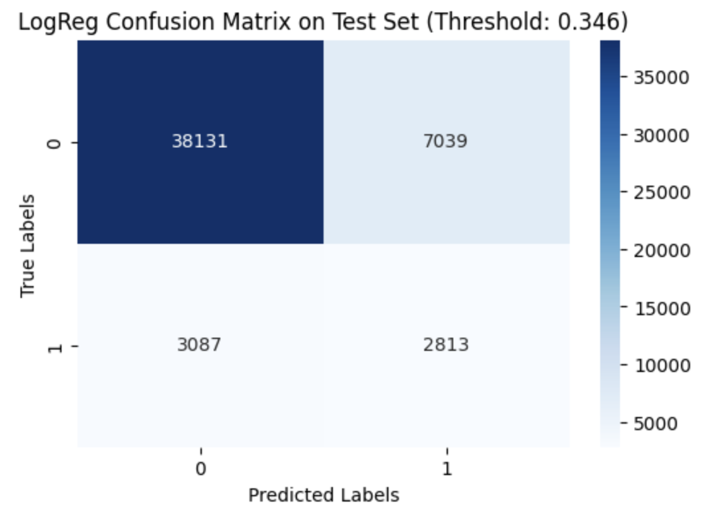
Results & Insights
MODEL LogReg + SMOTE w/ Threshold 0.346
Accuracy: 0.802
Precision: 0.286
Recall: 0.477
F1 – Score: 0.360
ROC - AUC :0.75
Notes:
A classifier that predicts everyone = non-default would get about 0.885 accuracy—but 0 recall for defaults. We intentionally traded some accuracy to catch many more true defaults (recall ≈0.48) and lift F1. That’s expected when optimizing for F1/recall versus pure accuracy.
Logistic Regression outputs probabilities; you chose 0.346 (not 0.5) because it maximized F1 on validation.
Lower threshold → more predicted defaults → higher recall, lower precision (more FPs).
Higher threshold → fewer predicted defaults → higher precision, lower recall (more FNs

Slide 27
Results & Insights Cont.
Data Science Perspective:
Smote improved recall of default
Threshold Tuning helped balance metrics
Moderate ROC: Classes Somewhat distinguishable
Business Perspective:
FN: Good Borrow – Risky = Loss in Profit
FP: Bad Borrower - Not Risky = Fewer loans approved / Missed opportunities
Businesses may prioritize recall if preventing losses is key, or precision if the approval efficiency matters.

Slide 28
Challenges & Future Plan
Data Imbalance
Highly imbalanced
Favored Majority class (Non-Default Predictions)
Overfitting Risk
Limitations
Features Low Correlation
New Features – Created Highly Correlated
Real World Application
No Missing Values and No Outliers
Impacts Reliability
Future Planning:
Cost – Sensitive Learning
ADASYN (Adaptive Synthetic Sampling)
Ensemble balancing

Slide 29
THANK YOU
Do you have any questions?
PLSS !!!

Slide 30
Citation
Dataset: https://www.kaggle.com/code/abdalrhman2002/loan-default-prediction-using-decision-tree

Slide 31
ALTERNATIVE RESOURCES

Slide 32
ICON PACK

